Slide 1
MODULE 2 ..PART3..IRS INFORMATION RETRIEVAL MODELS
I
1) covered till date…..
1.1)process of retravel….query, indexing, comparison, ranking results
1.2) main problem …accuracy of ranking algorthmn
1.3) solution….introduction of IR models
1.4)basic retrieval system…..user profile, filtering algorithm, database manager, database or storage
1.5)Process of retravel….user profile as per user query, query indexing and document indexing, comparison of both, results as per finding
1.6) limitation.. A user query may not be proper their for imporpoer query indexing thus irreverent results
1

Slide 2
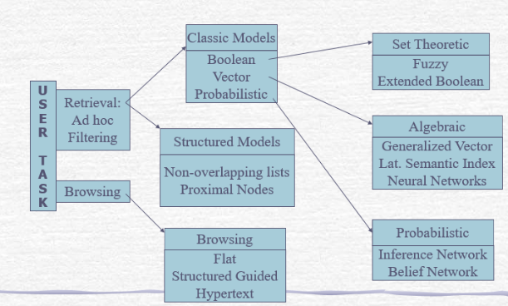
MODULE 2 ..PART3..IR MODELS
(1)taxonomy of Information retrieval system

Slide 3
MODULE2 ..PART3..IR MODEL
2) comparison between classic models
2.1)Boolean classic model:
a) simplest model and based on set theory and Boolean algebra,
b) it requires exact matching of documents thus only a few documents are retrieved,
c) non binary weighting of index terms not present as weights are only binary (1:document selected, 0: not selected)
d) no ranking of documents possible
2.2)Vector model:
a) partial matching also possible,
b) no binary weights assigned to index terms, this weighting scheme improves the performance,

Slide 4
MODULE2 ..PART3..IR MODEL
2) comparison between classic models…cont
2.2) Vector model: ……cont
c) partial matching strategy allows retrieval of documents by approximating the query conditions
d) the cosine ranking formula sorts the documents according to their degree of similarity to the query
e) As the weights assigned to indexing are only numerical they are non-sementic thus are not dependent i.e if 6 is related to query that doesnot mean that 7 is also related. It works on rang i.e from 0 to 6 . This forms one set.
f) To improve the performance either the query has to be modified or the feedback system has to be provided to the user
g) but still this model being more fast , simple and superior is mostly preferred

Slide 5
MODULE2 ..PART3..IR MODEL
2) comparison between classic models…cont
2.3)Probabilistic model: ……
a) Probability is almost like guessing as relevant and irrelevant and then forming two sets as the relevant and the nonrelevant sets
b) As it doesnot consider the frequency of relevance or non relevance of document so every time it has to go from the same cycle as it does not have memory information for self learning
c) The index terms are independent of each other after the indexed are weighted
3) Alternate set theory models
a) There are two models in this the fuzzy set model and extended Boolean model

Slide 6
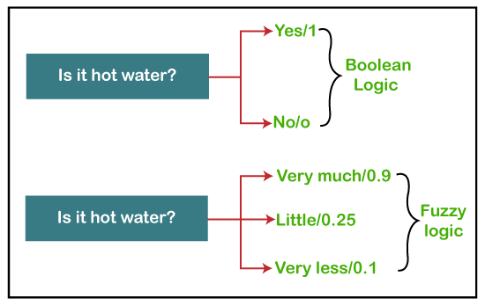
MODULE2 ..PART3..IR MODEL
3) alternate set theory mode….Fuzzy set model

Slide 7
MODULE2 ..PART3..IR MODEL
3) alternate set theory mode….3.1) Fuzzy set model
a)The Boolean model only gives two values logic 1 for document selected and logic 0 , for document not selected.
b) No relevance, only exact matching i,e a single truth value
c) but in reality their can be multiple truth values with most relevant as logic1 and less relevant as almost near to logic 0 .
d) thus a set of relevant documents. can be represented from 1 to 0 , but not 0.
e) this is called as the fuzzy set and more then one truth value in the range of 1 to 0 is called as the fuzzy logic
f) The process…
f.1)the documents and query are represented in terms of a set of keywords
f.2)Then the keywords are parsed and indexed called as description

Slide 8
MODULE2 ..PART3..IR MODEL
3) alternate set theory mode….3.1)Fuzzy set model..cont
f)The process…cont
f.4) These indexed descriptions are only partially related to the semantics contents of the document and input query
f.5) The matching of query term description to documents is not exact as boolean but vague.
f.6)Thus each query term when compared with the documents it produces a set defined as the fuzzy set and each document in the set has a degree of membership in the set (between 0 to 1)
g) Fuzzy set theory….

Slide 9
MODULE2 ..PART3..IR MODEL
3) alternate set theory mode….3.1)Fuzzy set model..cont
f)The process…cont
documents
tokens
Indexed
Token descriptors
compared
Sets of
Related documents
Indexed from 1 to 0 but not 0
1, 09, .0.8., 0.7………0.1
keywords
Indexed
Keyword descriptors
query

Slide 10
MODULE2 ..PART3..IR MODEL
3) alternate set theory mode….3.1)Fuzzy set mode
g) Fuzzy set theory….
g.1)They represent classes whose boundaries are not well defined.
g.2) The membership function is associated with each class
g.3)These functions take value from 1 to 0, Where 1 means full membership and 0 means no membership in the class, 1 to 0 indicate marginal membership in decreasing order from 1 to 0.
g.4)The three most commonly used operations with these classes( fuzzy set) are g.4.1)union…combining two classes
g.4.2)Intersection….finding out what is common in two classes
g.4.3)Complement ..converting a relative class to irrelevant class

Slide 11
MODULE2 ..PART3..IR MODEL
3) alternate set theory mode….3.1)Fuzzy set mode
g) Fuzzy set theory….
Class1 (Set1)
membership1
Union: class1 and class2
Class2(set2)
membership2
Intersection: common of calss1 and class2
Class3(set3)
membership3
Complement: relevant to irrelevent
Each entry in the class is associated a membership value 1 means full membership
0 means no membership, less then 0 means marginal membership

Slide 12
MODULE2 ..PART3..IR MODEL
3) alternate set theory mode….3.1)Fuzzy set mode
h)Fuzzy information retravel…
h.1)The document collection is created
h.2)The query is formed
h.3)The document and query is parsed for keywords
h.4)The keywords are indexed. The query index terms(one) and document index terms (many)
h.5)Thesaurus is performed..
1)this defines relationship with the index terms of the documents i.e relevant document and other documents related with that document as per the relationship defined between the index term of the relevant and other documents

Slide 13
MODULE2 ..PART3..IR MODEL
3) alternate set theory mode….3.1)Fuzzy set mode..h)Fuzzy information retravel
h.5)Thesaurus is performed..cont
2)For this term-term correlation matrix is defined also called as keyword connection matrix. The rows and columns are associated with the index terms of the documents which are to be related
3)The row and column terms are associated by defining normalized correlation factor Ci.l
4) Ci,l relates two index terms Ki (fuzzyset)and Kl(document)
5) Ci,l= (Ni,l)/(Ni+Nl-Ni.l)
Ni: number of documents which contain index term Ki
Nl: number of documents which contain index terms Kl

Slide 14
MODULE2 ..PART3..IR MODEL
3) alternate set theory mode….3.1)Fuzzy set mode..h)Fuzzy information retravel
h.5)Thesaurus is performed..cont
5) Ci,j= (Ni,l)/(Ni+Nl-Ni.l)
Ni,l: number of documents which contain both the index terms Ki and Kl
6) Now with help of correlation matrix , the fuzzy set is defined as
Ui,j=1- ∏ (1-Ci,j)
Ki € Dj
7)This associates each index term Ki with one fuzzy set of documents.
8)all the documents Dj in a particular fuzzy set has a degree of membership defined by Ui,j

Slide 15
MODULE2 ..PART3..IR MODEL
3) alternate set theory mode….3.1)Fuzzy set mode..h)Fuzzy information retravel
h.5)Thesaurus is performed..cont
9) Fuzzy set is associated with index term Kl
10)Document Dj belongs to the fuzzy set if any of its one index term Ki is associated with Kl of the fuzzy set.
11)It at least on Kl of the document Dj matches strongly with Ki then Ci,j =1 and Ui,j =1 then Ki it is a good fuzzy index and strongly coupled with the fuzzy set
12)If all the Kl of the document Dj matches loosely with Ki , then Ki is not agood fuzzy index of the fuzzy set then Ui,h=0
13)Conclusion….

Slide 16
MODULE2 ..PART3..IR MODEL
3) alternate set theory mode….3.1)Fuzzy set mode..h)Fuzzy information retravel
h.5)Thesaurus is performed..cont
13)Conclusion….
For documents Dj (0 to j) indexed as Kl they query, index as Ki, if Ci,j=1 then the query index Kl associated with document index Kl , thus the document Dj becomes the member fuzzy set.
3.2) extended boolean model
a) Boolean model is simple but exact matching and no ranking theirfore document set available as query output is very small and will not contain all the relevant documents
b)Extended Boolean model maintains the simplicity of boolan model and further…

Slide 17
MODULE2 ..PART3..IR MODEL
3) alternate set theory mode….3.1)Fuzzy set mode..h)Fuzzy information retravel
3.2) extended boolean model…cont
c)Boolean model is simple but exact matching and no ranking theirfore document set available as query output is very small and will not contain all the relevant documents
d)Extended Boolean model maintains the simplicity of the boolean model and further adds to it features like partial matching and term weighting for indexing
e)Suppose…
e.1)Consider a query having two keywords and operator . Let it be P1 and P2 the operation is U .the query is P1U P2

Slide 18
MODULE2 ..PART3..IR MODEL
3) alternate set theory mode….3.1)Fuzzy set mode..h)Fuzzy information retravel
3.2) extended boolean model…cont
e)Suppose…
e.2)Now for Boolean P1U P2 =(11) all document Dj showing this relevance to index terms will be selected and all other showing partial relevance that is presence of only one variable relevance will shown (00)
e.3) as for extended Boolean (00) were both variables as disjoin are not present will be considered as complete irrelevance and documents will not be selected.(11) were both variables present will be complete relevance (all documents selected) a vector will be drawn from 00 to 11 and above and below this i,e 10 and 01 conditions will be partial relevance

Slide 19
MODULE2 ..PART3..IR MODEL
6) Evaluation of IR models….
• Two of the evaluation measures are precision and recall.
6.1) Precision is the proportion of retrieved documents that are relevant.
6.2)Recall is the proportion of relevant documents that are retrieved.
Precision = (Relevant documents ∩ Retrieved documents)/Retrieved documents
Recall = (Relevant documents ∩ Retrieved documents)/Relevant documents
• When the recall measure is used, there is an assumption that all the relevant documents for a given query
are known. Such an assumption is clearly problematic in a web search environment, but with smaller test
collection of documents, this measure can be useful. It is not suitable for large volumes of log data.

Slide 20
MODULE2 ..PART3..IRS
Thank You

